Slide 1
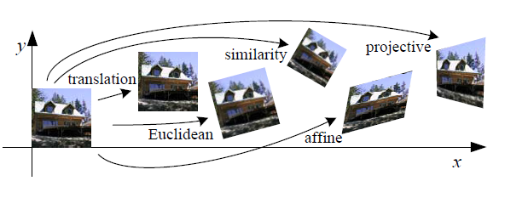
2D-2D Coordinate Transforms
rotation

Slide 2
2D-2D Coordinate Transforms
In many image systems, detected images are subject to geometric distortion, caused by camera perspective / position.
Transforms can correct (uniform) distortions of such images.
affine
scaling
translation
rotation

Slide 3
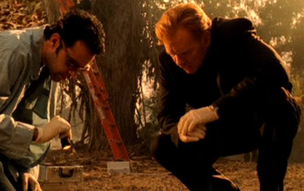

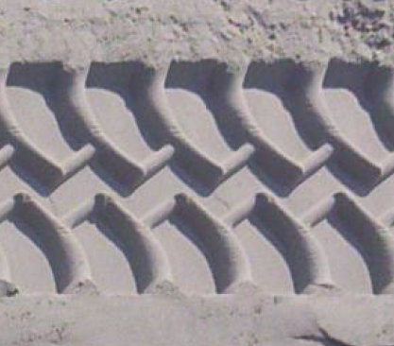
Distortion Example 1: a tire tread mark taken at a crime scene
A transformation could help ????
distortion rectification
The edges of the tire track (indicated in red) define the image distortion, from which the necessary rectification can be calculated.

Slide 4
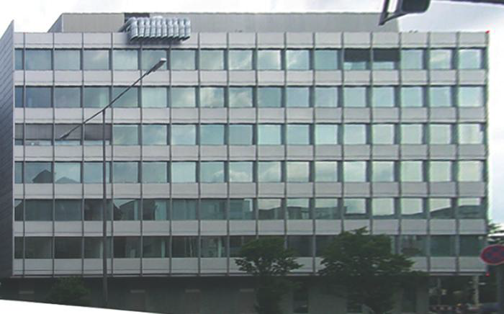
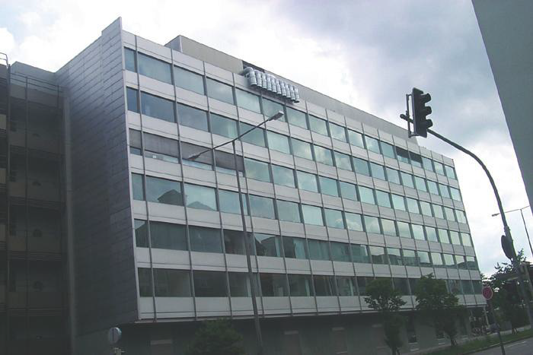
Distortion Example 2: Trapezoidal distortion due to a non-perpendicular view.
The rectification cannot compensate everything: see what’s wrong with the street light?

Slide 5
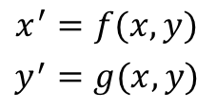


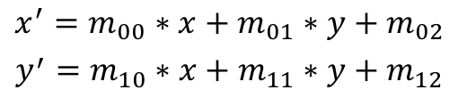
2D Transformations: Formula’s
Transformation in general:
$$I(x^{′},y^{′})=I(x,y)$$
In Formula’s:
$${x^{′}=f(x,y) \atop y^{′}=g(x,y)}$$
Linear transformations:
$${x^{′}=m_{00}∗x+m_{01}∗y+m_{02} \atop y^{′}=m_{10}∗x+m_{11}∗y+m_{12}}$$
Transformation coefficients:
a.k.a. ‘Warp-Affine Matrix’
$$M=\left[\begin{matrix}m_{00} & m_{01} & m_{02} \\ m_{10} & m_{11} & m_{12}\end{matrix}\right]$$

Slide 6
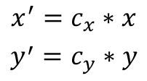
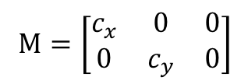
2D Transformations: Scaling
Warp-Affine Matrix
$$M=\left[\begin{matrix}c_{x} & 0 & 0 \\ 0 & c_{y} & 0\end{matrix}\right]$$
Linear transformations:
$${x^{′}=c_{x}∗x \atop y^{′}=c_{y}∗y}$$

Slide 7


Solving the ‘Pixel – Mismatch problem’
We know the transformation matrix:
$$\left(x^{′},y^{′}\right)=M∙(x,y)$$
Input
p1
In practice the inverse calculations is done:
Output
$$\left(x,y\right)=M^{−1}∙(x′,y′)$$
p2
(1) We scan through every point (x’, y’) in the output image
(2) Calculate point (x, y) in the input image with where we get the
intensity value to use.
(3) If (x, y) falls ‘in between pixels’, take the value at the nearest
integer point. (interpolation)
Input
p1
Output
p2

Slide 8
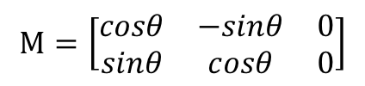
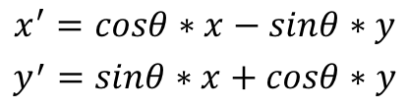
2D Rotations: Formula’s
In matrix form:
$$M=\left[\begin{matrix}cosθ & −sinθ & 0 \\ sinθ & cosθ & 0\end{matrix}\right]$$
y’
y
In formula’s:
$${x^{′}=cosθ∗x−sinθ∗y \atop y^{′}=sinθ∗x+cosθ∗y}$$
x’
O
x

Slide 9
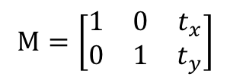
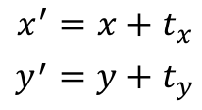
2D Transformations: Translation
y’
In matrix form:
$$M=\left[\begin{matrix}1 & 0 & t_{x} \\ 0 & 1 & t_{y}\end{matrix}\right]$$
y
In formula’s:
$${x^{′}=x+t_{x} \atop y^{′}=y+t_{y}}$$
t_{x}
t_{y}
x’
O
x

Slide 10
For Math Insiders: Homogeneous Coordinates
So-called Homogeneous Coordinates are used:
Simply means to append a 1 as an extra element
If the 3rd element ever becomes ≠ 1,
Actual calculation:

Slide 11
Demo with open CV
program affine.py

Slide 12
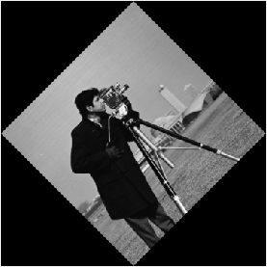
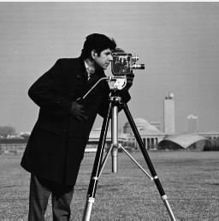
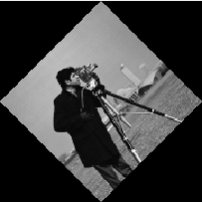
Example
Image A is modified by the following affine transform where
Image B
Image A
Note: in OpenCV an affine transform is a 2x3 matrix (M), the first two columns of this matrix encode rotation, scale and shear. And the last column encodes translation, see function warpAffine().
Given a point , the affine transformation moves it to point

Slide 13
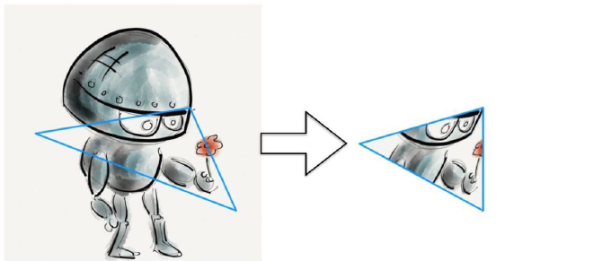
OpenCV can compute the Affine Map Matrix from points
How about warping one triangle to another ?

Slide 14
Projective or Perspective Transform - Homography
To gain greater flexibility
Most general type of linear 2D – 2D transform
M is an arbitrary 3 x 3 matrix
Each element in the destination array is computed from the element of the source array at the location given by:

Slide 15
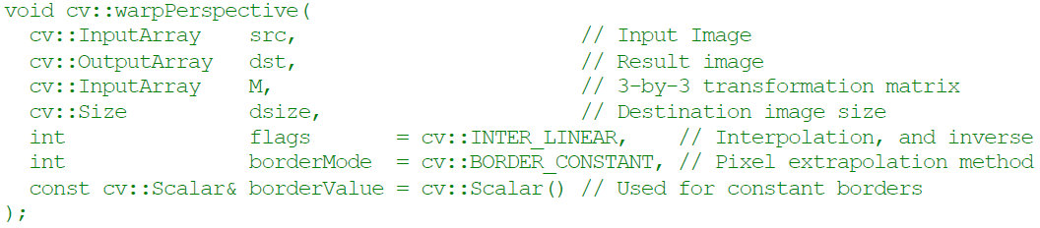
Perspective Transformation OpenCV
Computing Perspective transformation matrix M

Slide 16
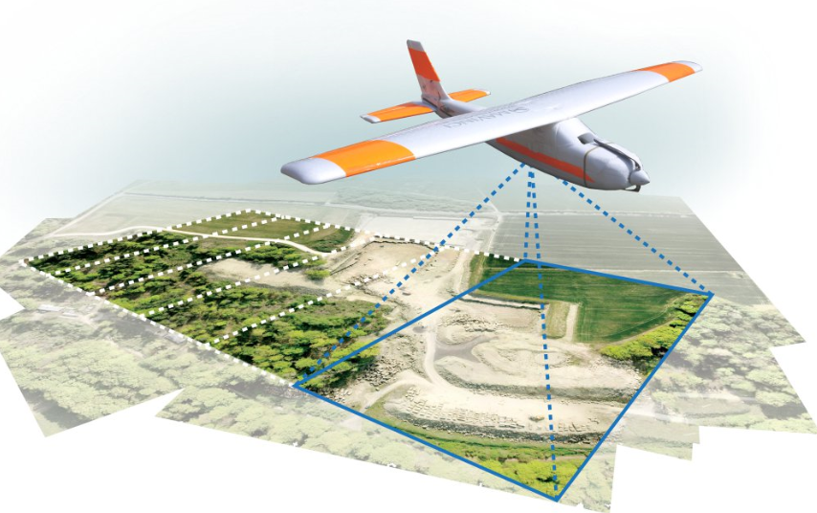
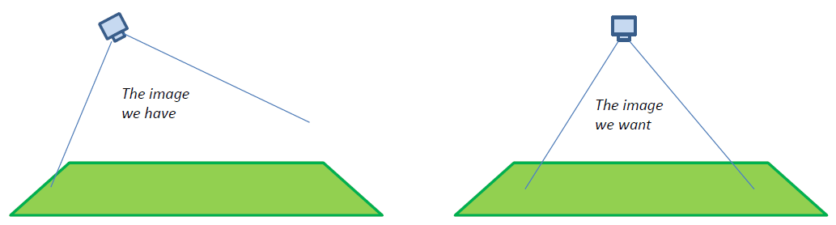
Application example: Generating an Orthophoto
An “orthophoto” is an aerial photograph geometrically corrected such that the scale is uniform. Like a map, an orthophotograph can be used to measure true distances.
Essentially, we want to take the image taken by a camera at some off‐axis angle, and transform it as if it were taken looking straight down.
One way to calculate the transform is to find some known “control points” in the input image and specify where those points should appear in the output image.
Then calculate the transform using least squares fitting.

